Slide 1
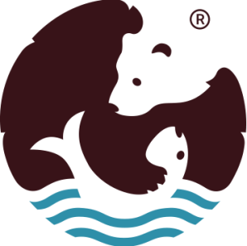
Experience of participation in international projects for the construction of water supply and water treatment facilities in the Ladoga area
Anna Golovanova, project manager of ANO Energy Efficiency Cenre
on behalf of Karelvodokanal LLC

Slide 2
Karelvodokanal LLC
Guaranteeing provider of centralized water supply and sanitation services in Sortavala district
Established in 2015
Responsible for over 73 km of water supply pipes and over 40 km of sewage pipes
Has its own laboratory
Active participant of international projects in the spheres of environmental protection and infrastucture development (TACIS, Karelia ENPI, Karelia CBC)
Karelvodokanal.ru
Facebook.com/karelvodokanal

Slide 3
Karelia CBC Programme
KA219 (2011-2013)
KA6000 (2018 – 2021)
KA10010 (2020 – 2022)
KA11022 (2020 – 2022)
КА5049 (2019 - 2022)

Slide 4
Project KA219 Groundwater supply in Sortavala district (2011-2013)
Rivers/lakes are primary water supply sources for settlement in the Republic of Karelia vs groundwater in Finland
Kaalamo and Ruskeala are supplied with water from the Tohmajoki river (high in humus, color, iron)
Project goals:
Learn from Finnish experience
Develop design and estimate documentation for groundwater supply infrastructure
Laying the foundation for construction of modern facilities and offering clean water to the local population
Budget: 285 000 EUR

Slide 5
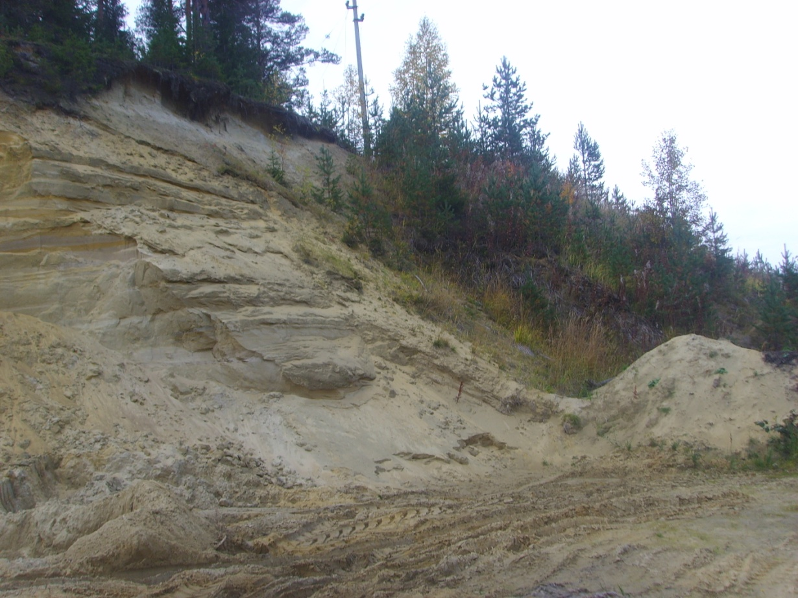
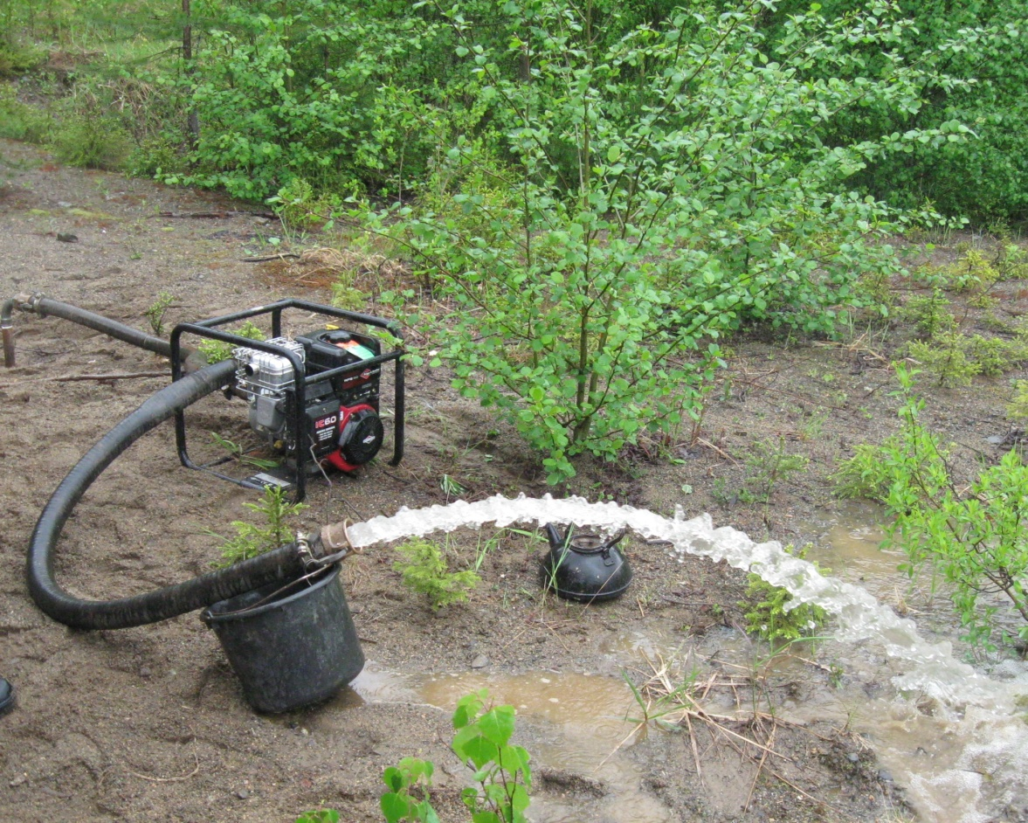
Project KA219 Groundwater supply in Sortavala district (2011-2013)
Pumped clean water
Sand quarry

Slide 6
Project KA6000 Water supply and water treatment facilities improvement in Sortavala (2018-2021)
2 main components:
a) drinking water quality improvement
Old water intake was located very close to the shore (75 m) and at the depth of only 3,5 m.
b) waste water treatment improvement
Two waste water outlets (N8 and N10) are located in the town centre were built in the beginning of the 20th century and since those times the wastewater was discharged through these outlets directly to Ladoga water.
Budget: 3.9 mln EUR

Slide 7
KA6000 Goals
1. Raising the professional competence of engineering and managerial staff of Karelian municipal utility companies and municipal administrative bodies.
2. Improved tap-water quality used by local citizens, foreign and domestic visitors of Sortavala district.
3. Reduced pollution of the Ladoga Lake and consequently Baltic Sea waters.

Slide 8
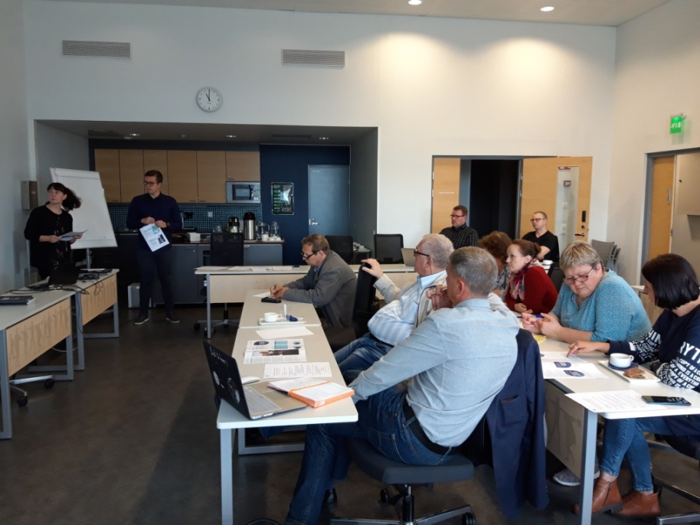
KA6000 Implementation
By October 2019 all capacity-building events and site visits were arranged by project partner SYKE (Finnish Environment Institute):
water supply and treatment facilities in Imatra and Savonlinna
training seminar in Joensuu
study trip to Savonlinna
to observe laying pressure
pipes underwater
through a waterbody

Slide 9
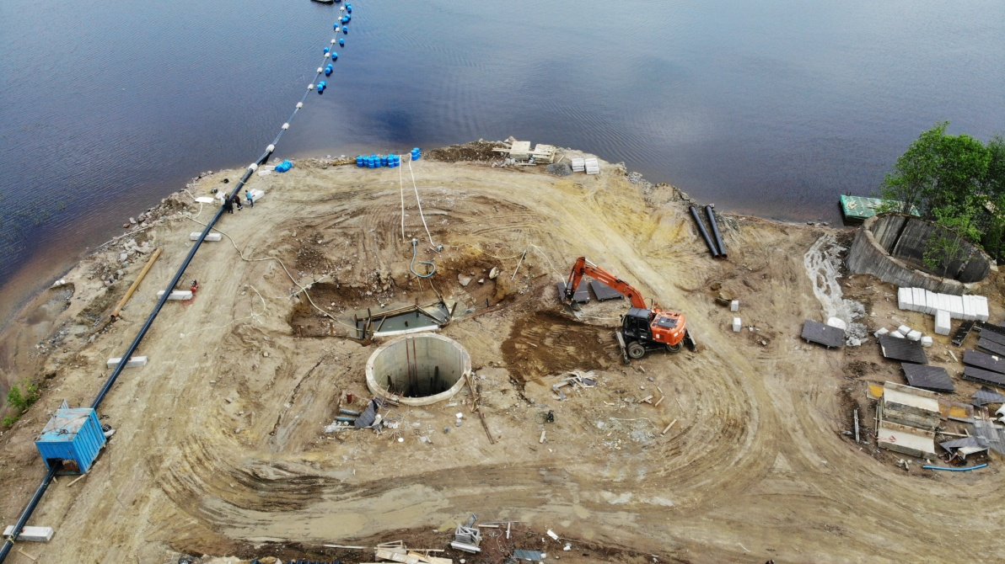
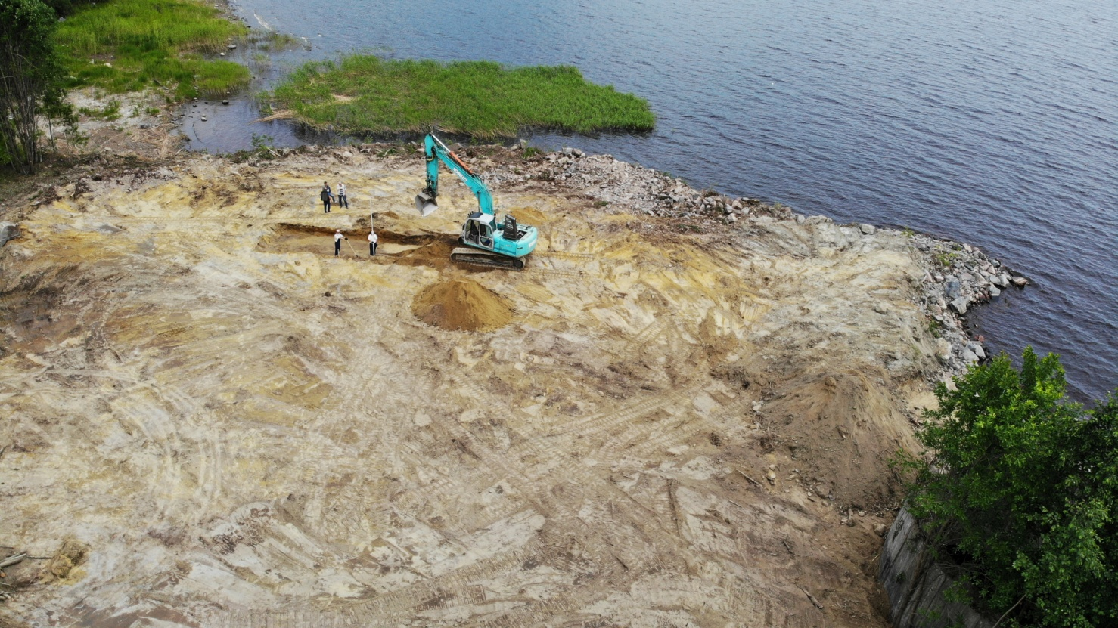
KA6000 Implementation
Water supply system:
Pumping station of the 1 lift under construction
New water intake: gravity pipelines were laid down to the lake bottom and connected to deep-water headers

Slide 10
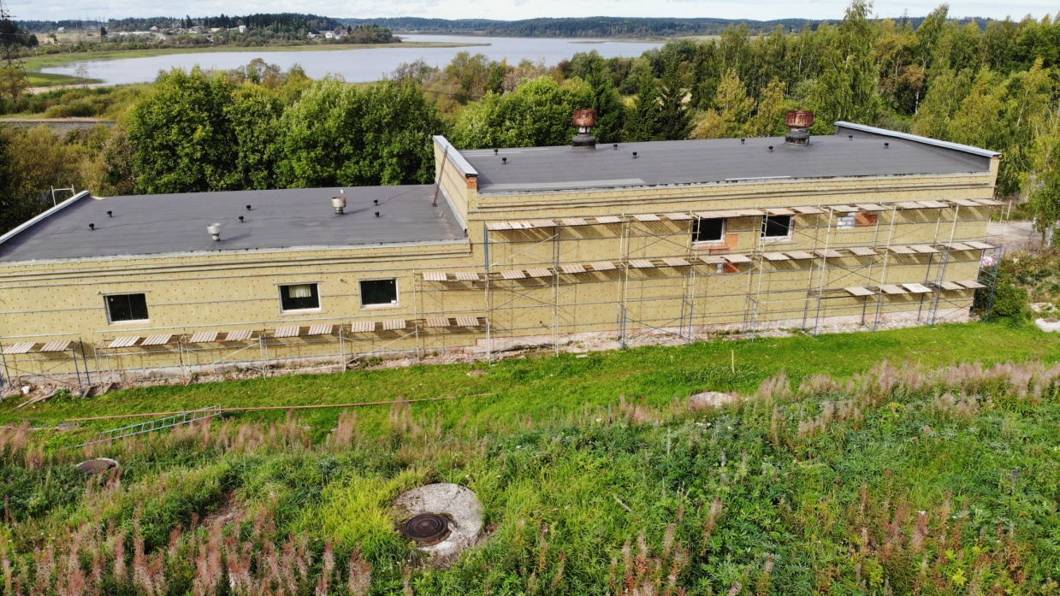
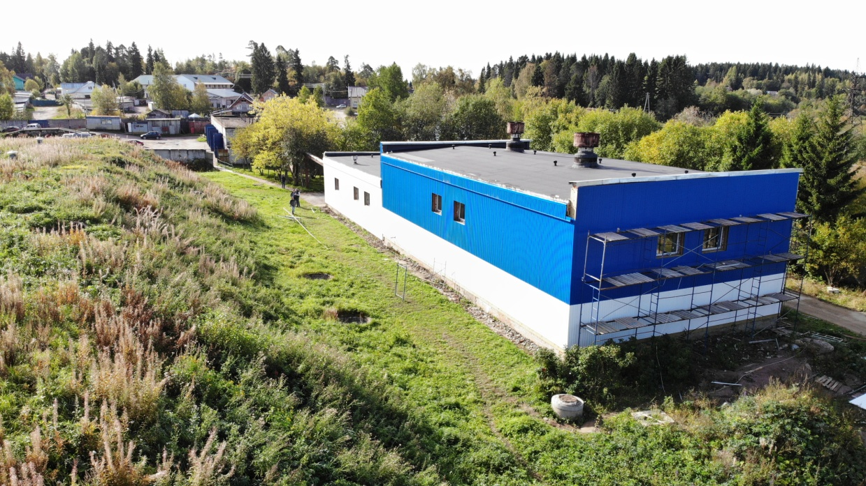
KA6000 Implementation
Water supply system:
Pumping station of the 2 lift was renovated

Slide 11
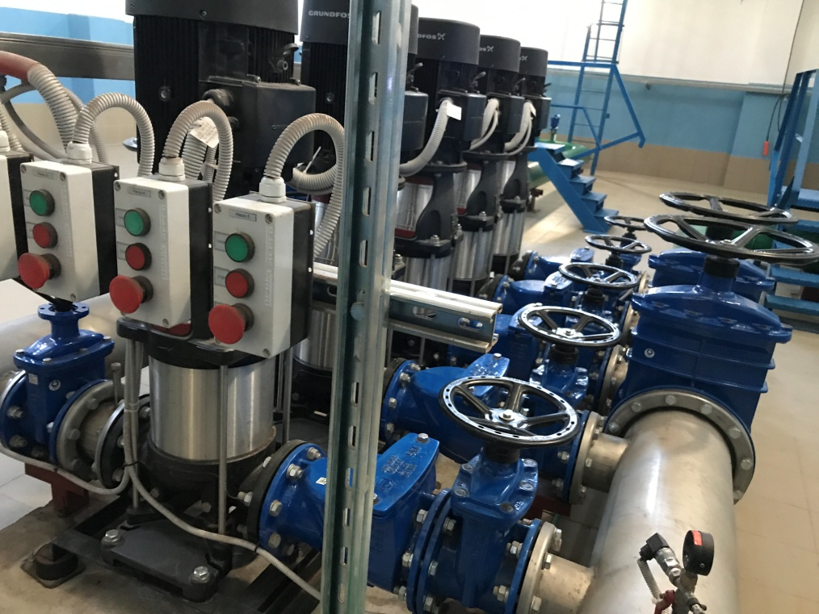
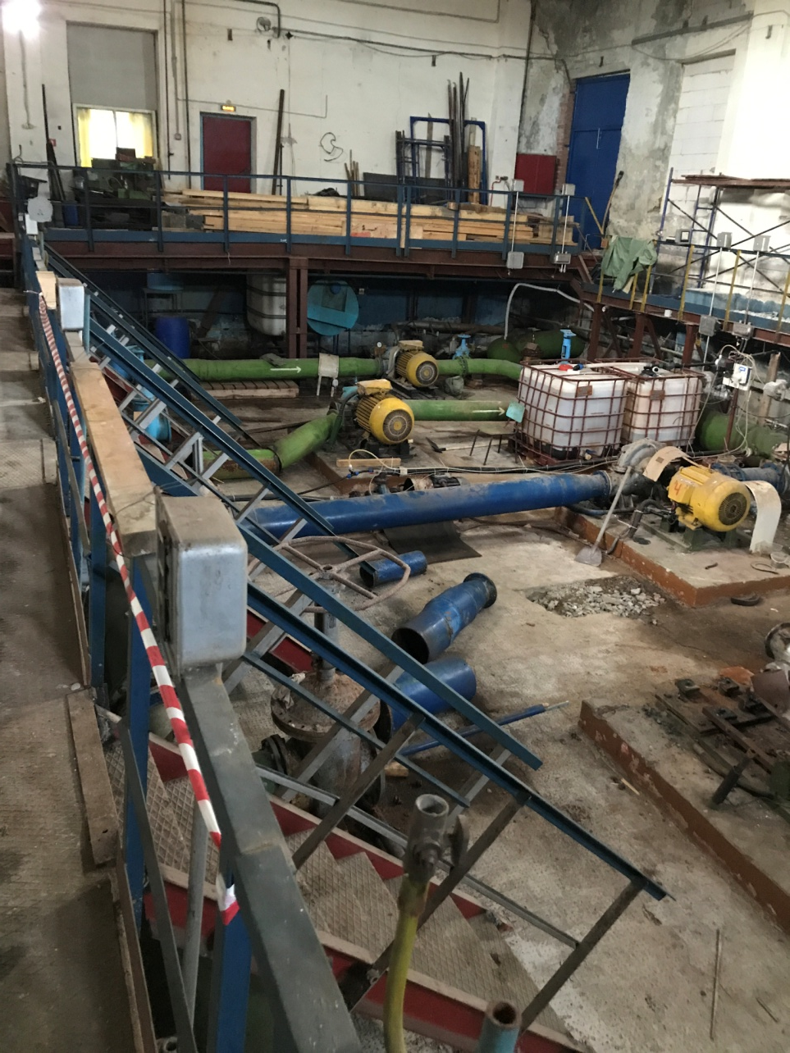
KA6000 Implementation
Water supply system:
A new module pumping station installed

Slide 12
KA6000 Implementation
Waste water treatment improvement:
Tendering for closing of wastewater discharge points
Sewage pumping stations are connected to electricity
Necessary permits for groundwork are obtained
Promotion and visibility:
Local and regional television channels
Local radio
Mass media (Karjalainen, Yle, Kaarna pohjois-Karjalan biosfäärialue, etc.)

Slide 13
Project KA10010 Improving the water quality for local use of water resources and ecological state in the cross-border rivers Koitajoki and Tohmajoki
Both Tohmajoki and Koitajoki flow into Ladoga and their water quality and ecological states affect its ecological state
The goal is to find ways to improve the water quality and ecological state in the rivers Tohmajoki and Koitajoki and thus in Lake Ladoga

Slide 14
Project KA10010 Improving the water quality for local use of water resources and ecological state in the cross-border rivers Koitajoki and Tohmajoki
The main outputs of the project will be
Water analyses are performed and monitoring scheme of the physical & chemical state of the cross- border rivers is developed.
Technical proposals and plans for reducing the load from Helylä to Ladoga are given, design and estimate documentation for further construction is developed
Knowledge is exchanged and results disseminated to stakeholders and made public

Slide 15
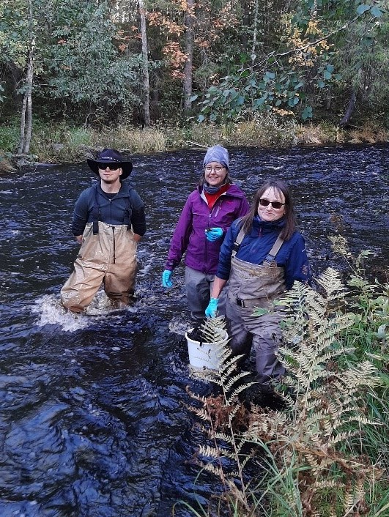
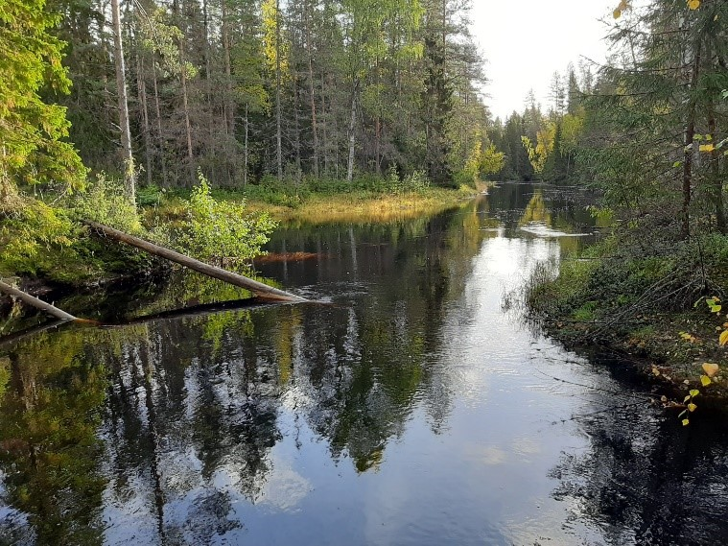
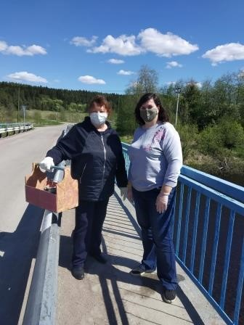
Project KA10010 How it is going

Slide 16
KA11022 Improvement of water resource management in the Northern Ladoga border region
Three basic problems in small settlements of Karelia (including Kaalamo):
discharging of untreated sewage water into water bodies or terrain,
bad quality tap water not safe for drinking,
residue containing harmful chemical compounds which is contaminating soil and air.
Budget: 3.3 mln EUR
Started in October 2020, currently in the early stages.

Slide 17
KA11022 Goals
Most appropriate modern technologies and equipment for the purification of drinking water and sewage treatment in small settlements are identified with regard to Finnish experience.
The water supply system in Kaalamo settlement is improved (on the basis of preliminary studies and design estimates prepared within the CBC Karelia project KA219 “Ground water supply in Sortavala district”)
Set of construction documentation is developed and new automated water treatment plant is built based on Finnish experience.
The experience in the operation of such facilities in Karelia and Finland is presented to a wide audience

Slide 18
KA11022 Goals
Most appropriate modern technologies and equipment for the purification of drinking water and sewage treatment in small settlements are identified with regard to Finnish experience.
The water supply system in Kaalamo settlement is improved (on the basis of preliminary studies and design estimates prepared within the CBC Karelia project KA219 “Ground water supply in Sortavala district”)
Set of construction documentation is developed and new automated water treatment plant is built based on Finnish experience.
The experience in the operation of such facilities in Karelia and Finland is presented to a wide audience

Slide 19
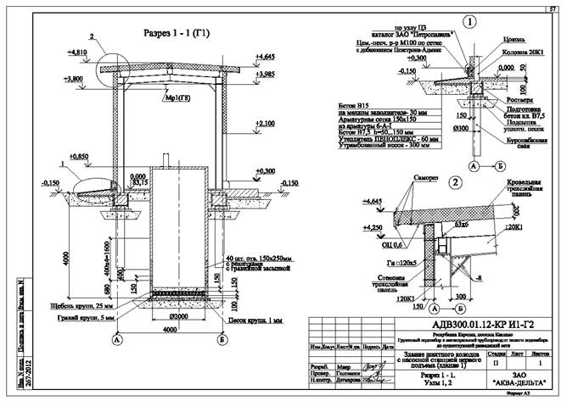
KA11022 Vision

Slide 20
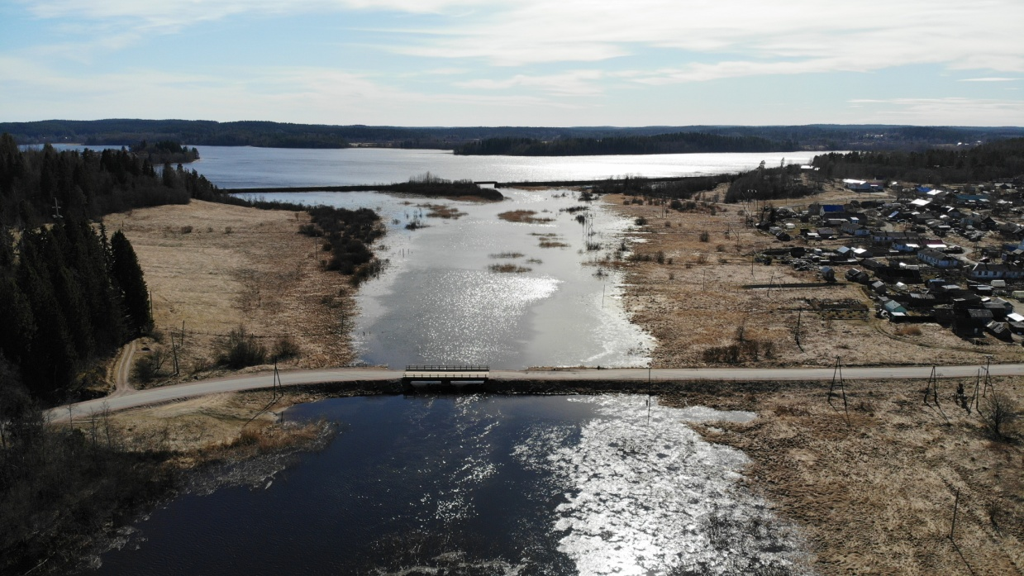
KA5049 Clean potable water and healthy environment in Sortavala region
Zaozerny settlement is also supplied from surface water that does not meet sanitary standards but ground water is not available here.
Solution selected – connection to Sortavala city water supply via a water conduit that crosses a water body.
In the framework of the
project, design and
estimate documentation
for construction needed
is to be developed.

Slide 21
Thank you for your attention!
Anna Golovanova
Project manager
ANO Energy Efficiency Centre
Anja.nikulina@gmail.com
Karelvodokanal LLC
Karelvodokanal.ru

